Slide 1
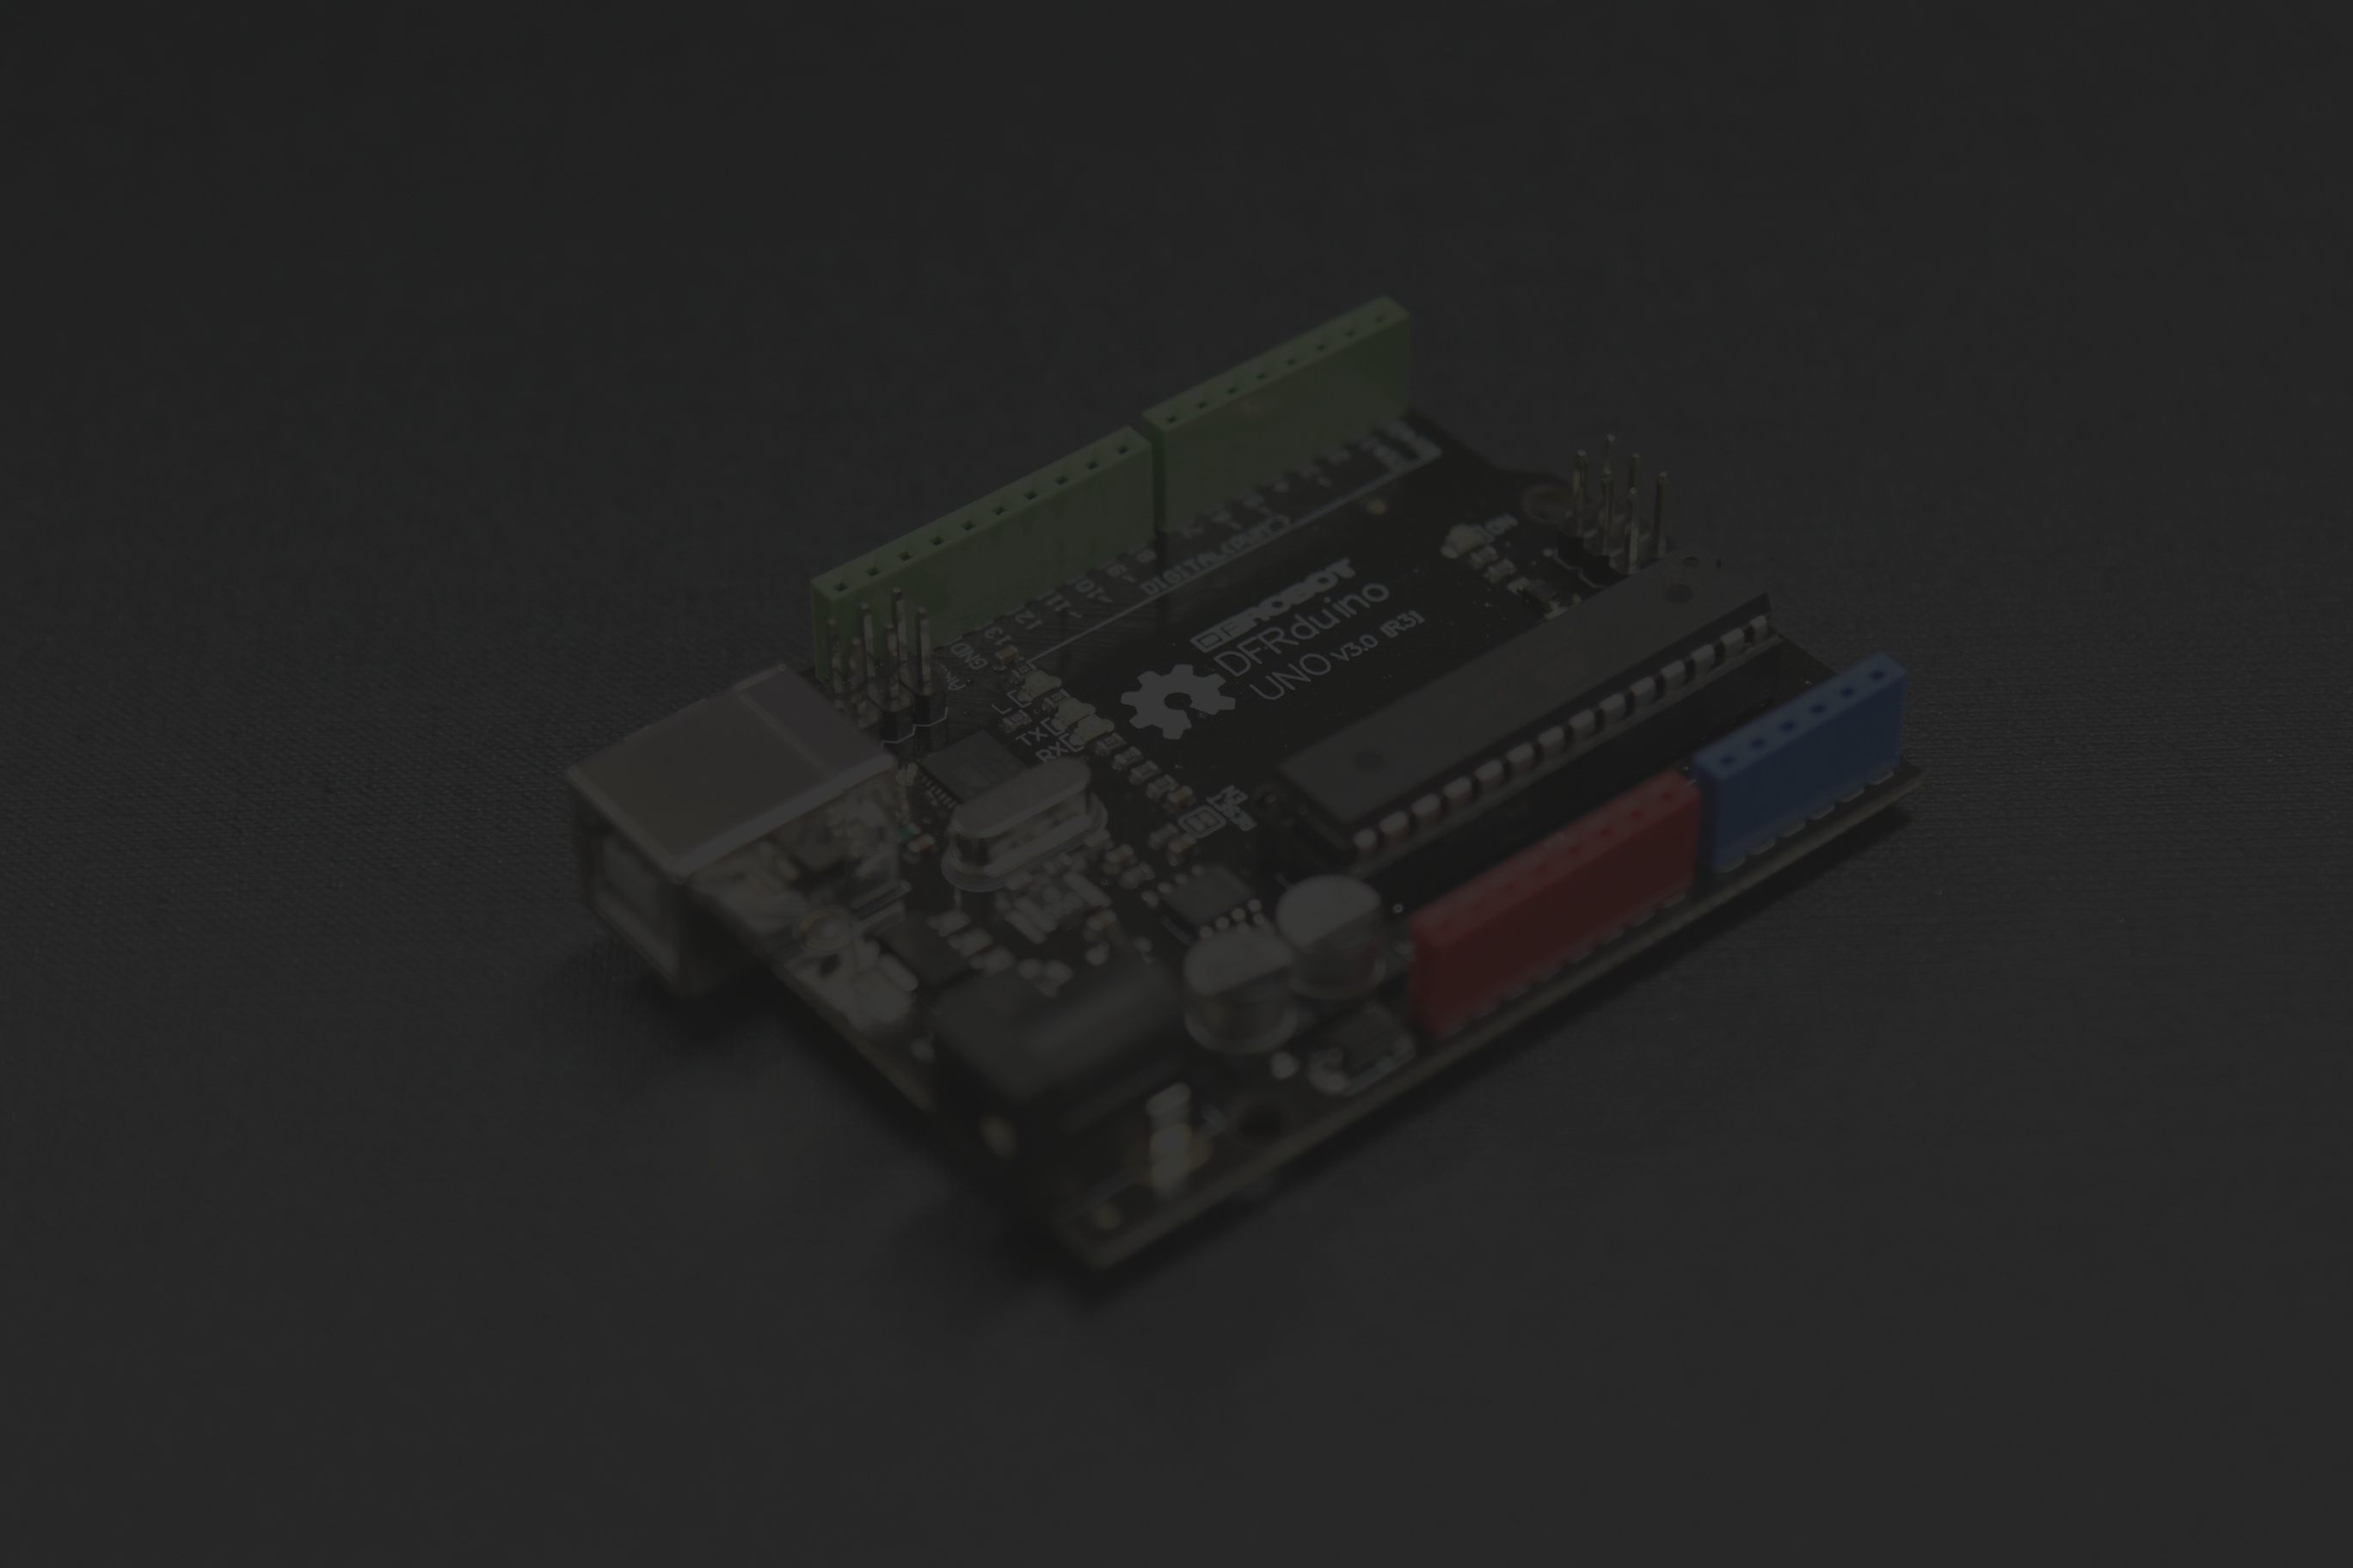


BLUETOOTH CONTROLLED RC CAR

Slide 2
6- مريم ايهاب يحي جمال طه 7- اصيلة نبيل عوض محلاب 8- سارة محمد طه حسين 9- عفاف نادي سعد احمد 10- نانسي نادر علي محمد 11- فرح اشرف احمد الاشقر 12- منه الله ابراهيم عبد الحليم عمر
PARTICIPANTS
1- عبد الرحمن منتصر محمد حسن
2- عمرو محمد صالح العزب
3- عبد الله محمود عبد الله ابراهيم علام
4- محمد اسامة محمد الجبالي
5- محمود عادل محمود ابراهيم الشوربجي

Slide 3
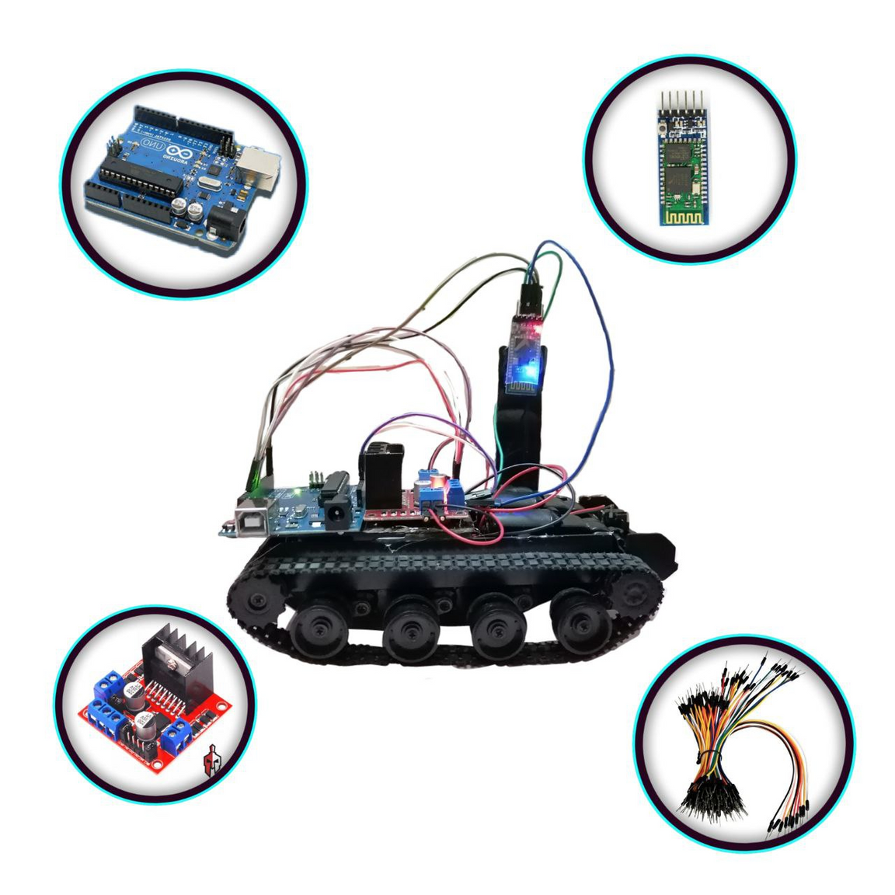
COMPONENTS

Slide 4
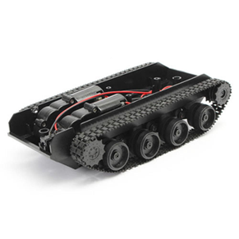
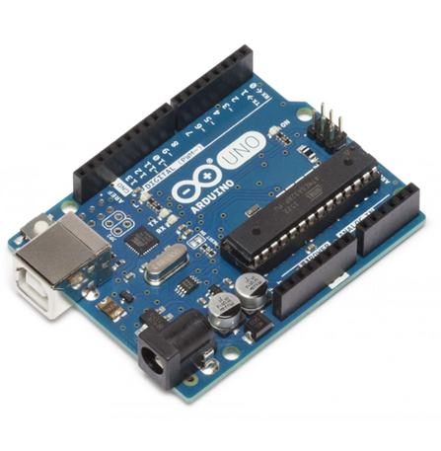
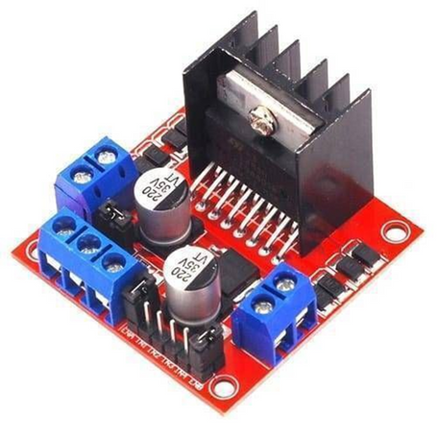
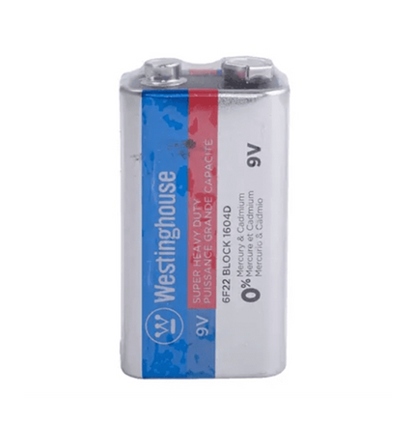
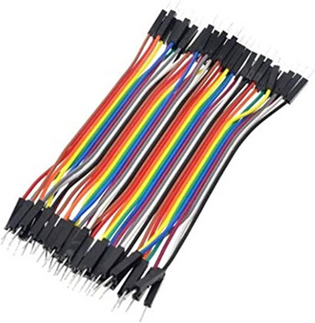
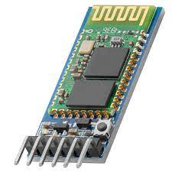
SMART CAR ROBOT CHASSIS
ARDUINO UNO
L298N MOTOR DRIVER
9V BATTERY
CONNECTING WIRES
HC-05 BLUETOOTH MODULE

Slide 5

CIRCUIT DIAGRAM

Slide 6
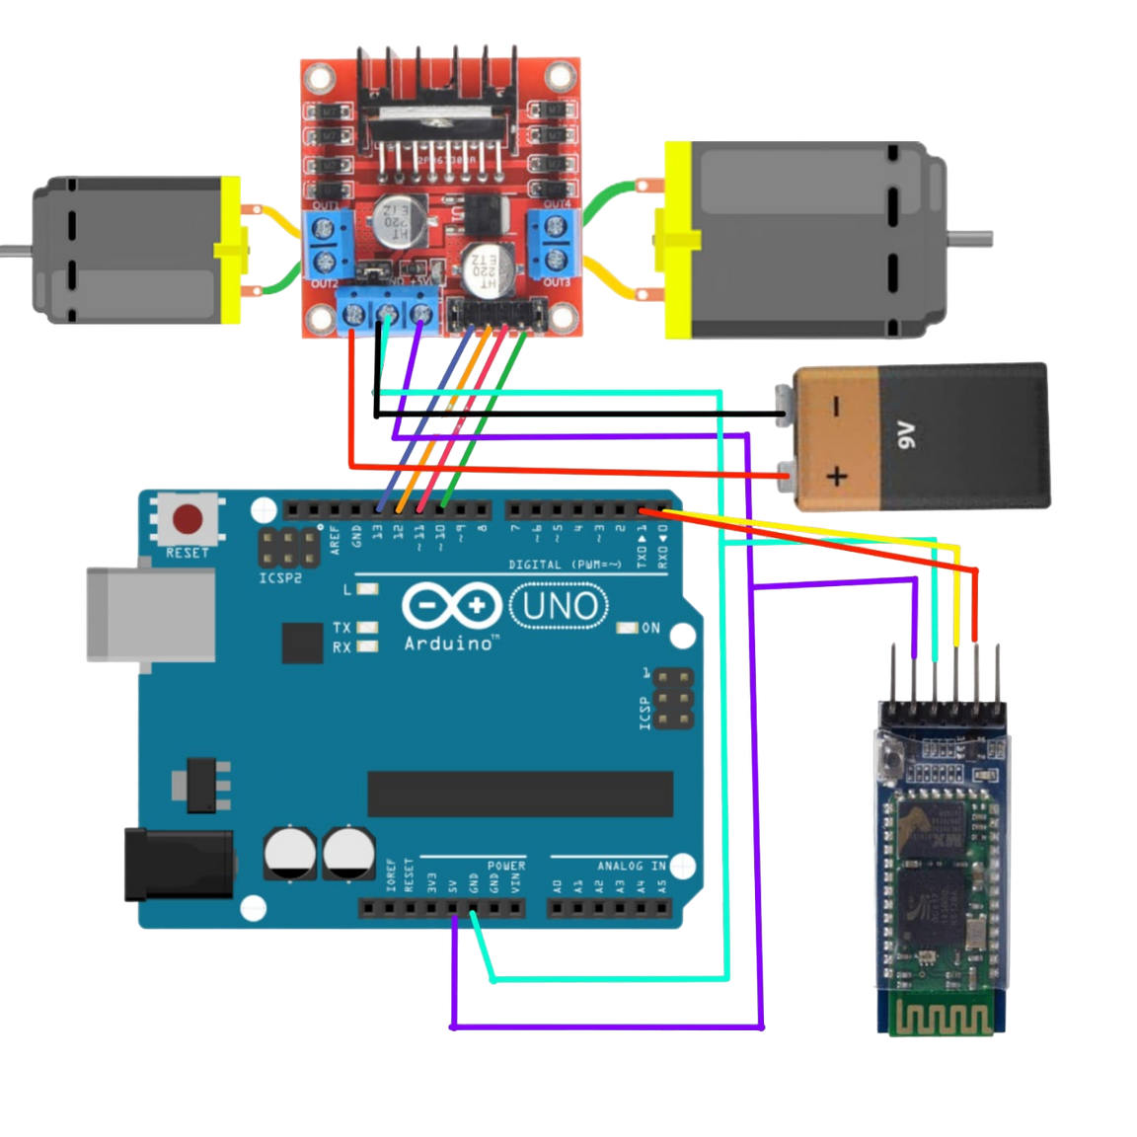



Slide 7

CODE

Slide 8
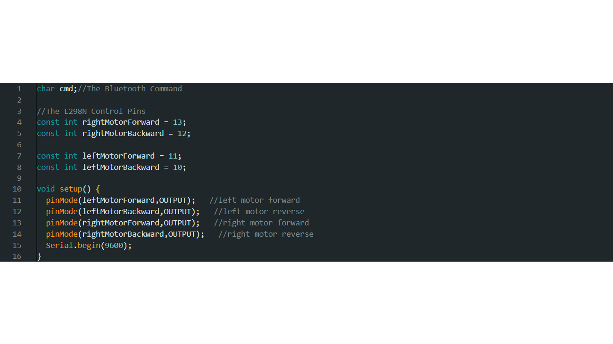
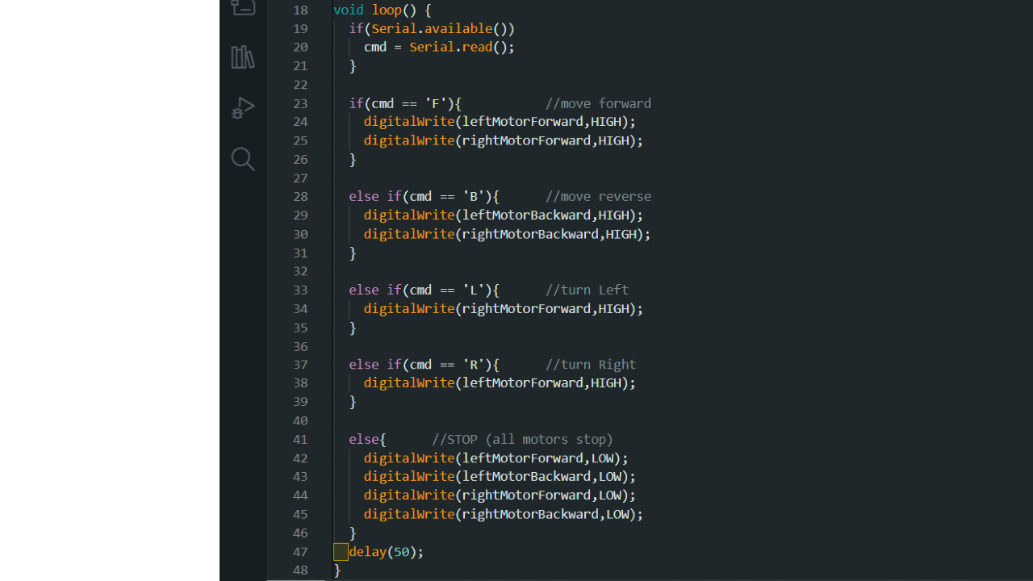

Slide 9
HOW IT WORKS

Slide 10

HOW THE CODE WORKS
The code reads a character value from a Bluetooth device, and based on the received command, it controls the car's movement.
The code starts with defining the pins used to control the car's motors. Then, in the setup function, it sets the defined pins as output pins and starts the serial communication.
In the loop function, the code waits for incoming data from the Bluetooth device. Once a character is available, it is stored in the variable "cmd." Then, the code checks the value of "cmd" and executes the corresponding action.

Slide 11
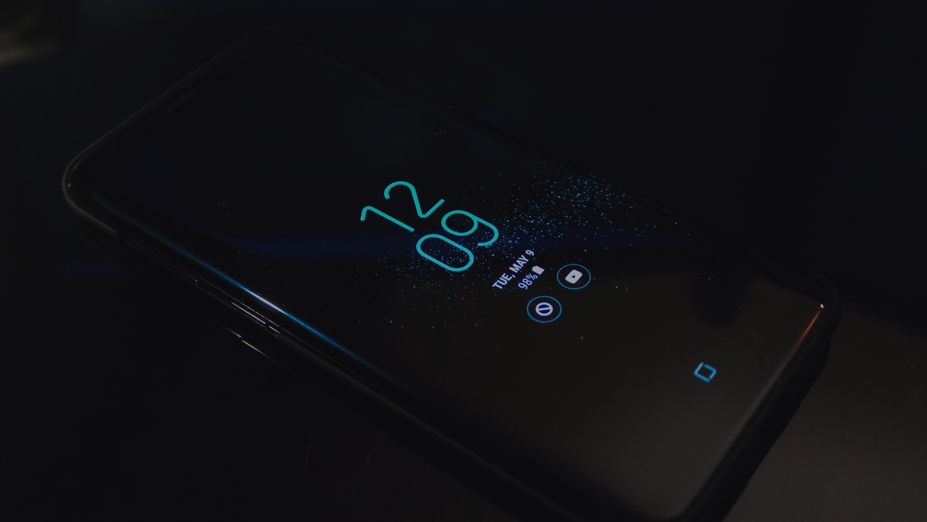

MOBILE APP

Slide 12
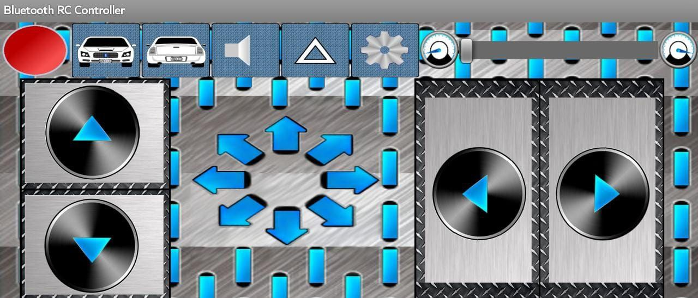
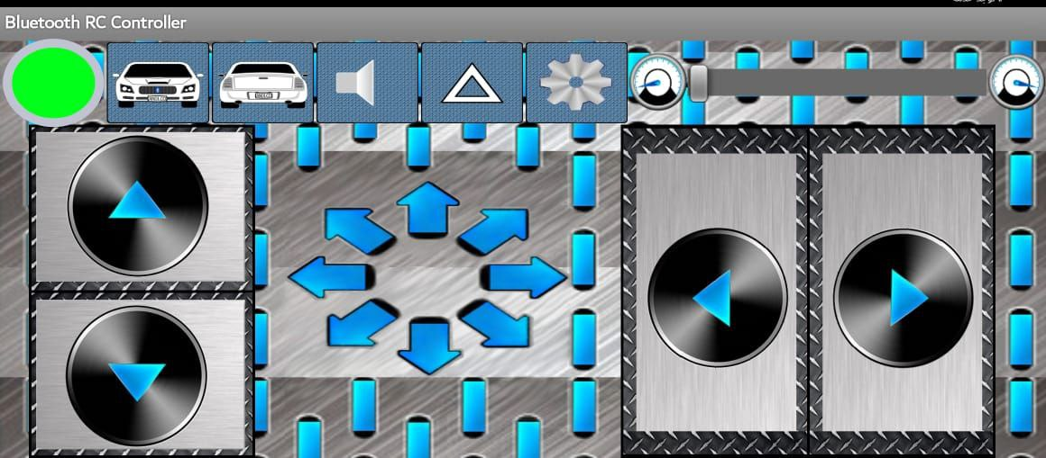
OFF
ON

Slide 13
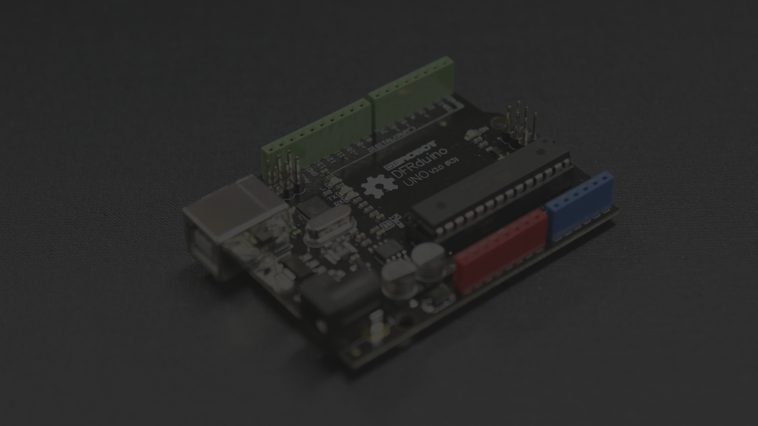
THANK YOU

